Slide 1
Chapter 4: Applications of derivatives
much calculus
wow
Brought to you by DG “Bad-boy” Kim
many derivativ
such amaze

Slide 2

Finding Extrema
Local Extreme Value Theorem:
If a function f has a local maximum value or a local minimum value at an interior point c of its domain, and if f’ exists at c, then f’(c) = 0. (page 189)
English Translation:
If at some point there is a local min or max, the slope will equal zero at that point, assuming the derivative is defined at that point.
Quick definition (because that’s fun to do): Critical point is a point on the function were either the slope = 0 or the slope doesn’t exist. So if a problem ever asks for a critical point, now you know what to look for, dog.

Slide 3
Confirming extrema
You can confirm if an extreme is either a min or a max by taking the second derivative, which shows concavity.
Here’s a nifty little chart yay:
First derivative | Second derivative | Meaning
Zero | Positive | Minimum
Zero | Negative | Maximum

Slide 4
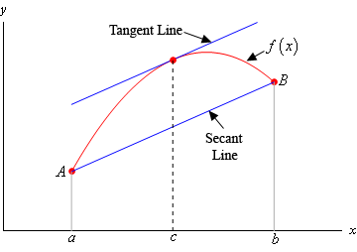

Mean Value Theorem
This is fun to do visually:
$$f^{′}\left(c\right)= \frac{f\left(b\right)−f(a)}{b−a}$$

Slide 5
Modeling and Optimization
Optimize – make something a minimum or a maximum.
Here’s the patented foolproof method to solving optimization problems.
If possible, draw a sketch of your problem.
Write a general equation for what you’re trying to optimize (for example, Volume or Area).
Find some of your unknowns in terms of each other and substitute in values.
Take the derivative of the resulting function and find where it equals zero.

Slide 6
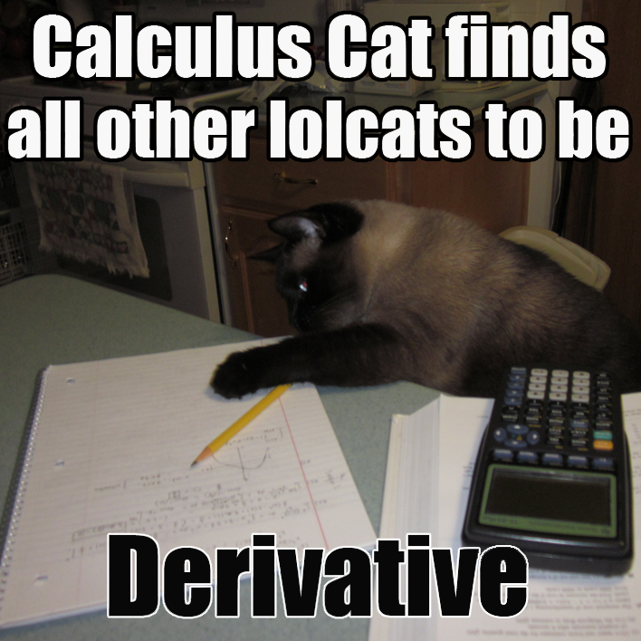
One wee example
We need to enclose a field with a fence. We have 500 feet of fencing material and a building is on one side of the field and so won’t need any fencing. Determine the dimensions of the field that will enclose the largest area.

Slide 7

STEP Han-ha
If possible, draw a sketch of your problem.

Slide 8


STEP Two
Write a general equation for what you’re trying to optimize (for example, Volume or Area).
$$A=xy$$

Slide 9
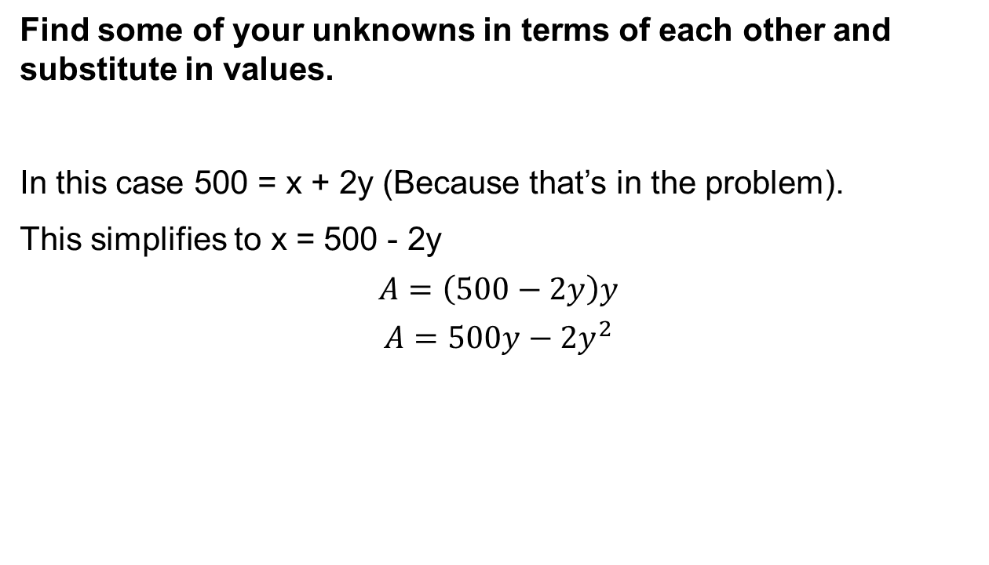
STEP Tres
Find some of your unknowns in terms of each other and substitute in values.
In this case 500 = x + 2y (Because that’s in the problem).
This simplifies to x = 500 - 2y
$$A=\left(500−2y\right)y$$
$$A=500y−2y^{2}$$

Slide 10
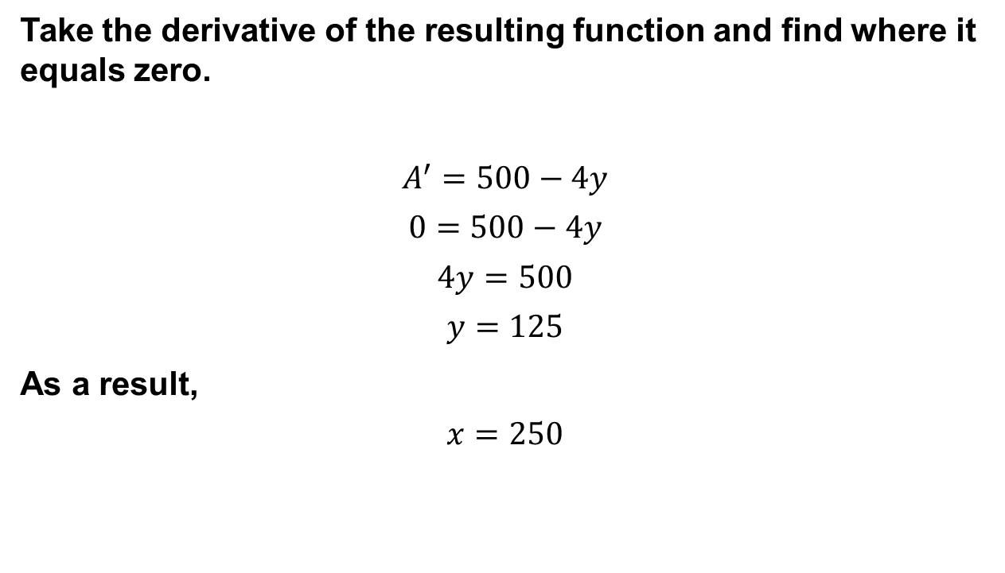
STEP Vier
Take the derivative of the resulting function and find where it equals zero.
$$A^{′}=500−4y$$
$$0=500−4y$$
$$4y=500$$
$$y=125$$
As a result,
$$x=250$$

Slide 11
So that wasn’t too hard
So let’s do one more example!
Find the greatest area of a rectangle that can be inscribed inside a circle of radius 4? (Use a Cartesian Plane)

Slide 12
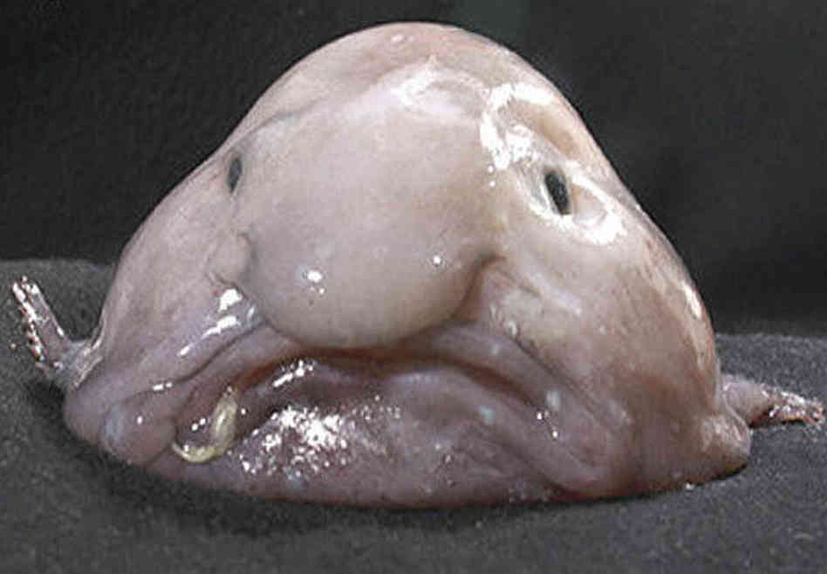
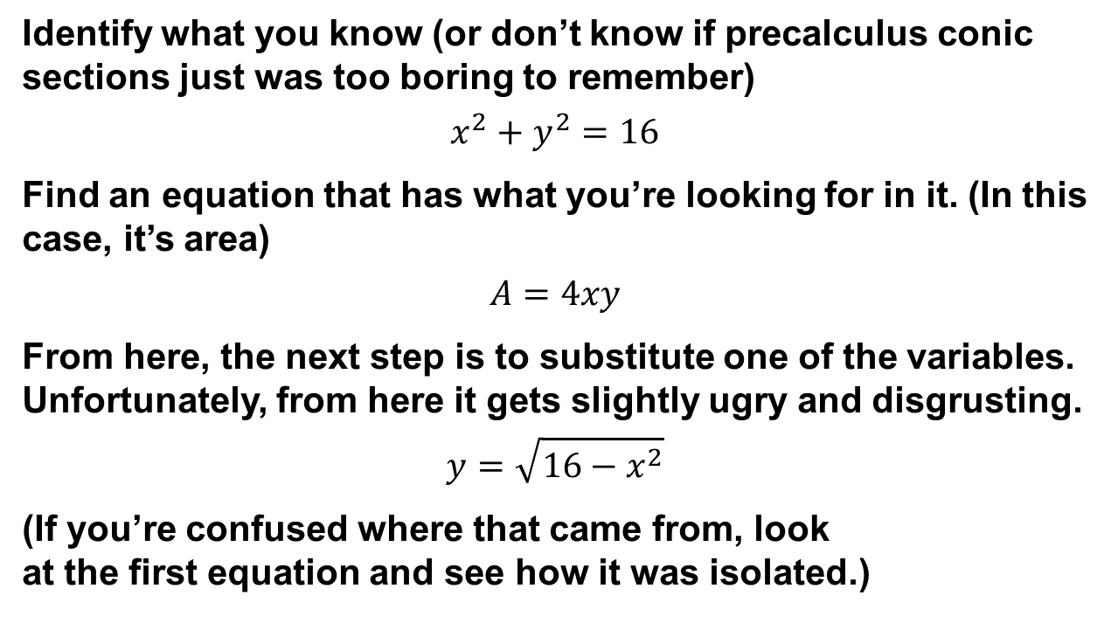
Just Solve it bro
Identify what you know (or don’t know if precalculus conic sections just was too boring to remember)
$$x^{2}+y^{2}=16$$
Find an equation that has what you’re looking for in it. (In this case, it’s area)
$$A=4xy$$
From here, the next step is to substitute one of the variables. Unfortunately, from here it gets slightly ugry and disgrusting.
$$y=\sqrt{16−x^{2}}$$
(If you’re confused where that came from, look
at the first equation and see how it was isolated.)

Slide 13

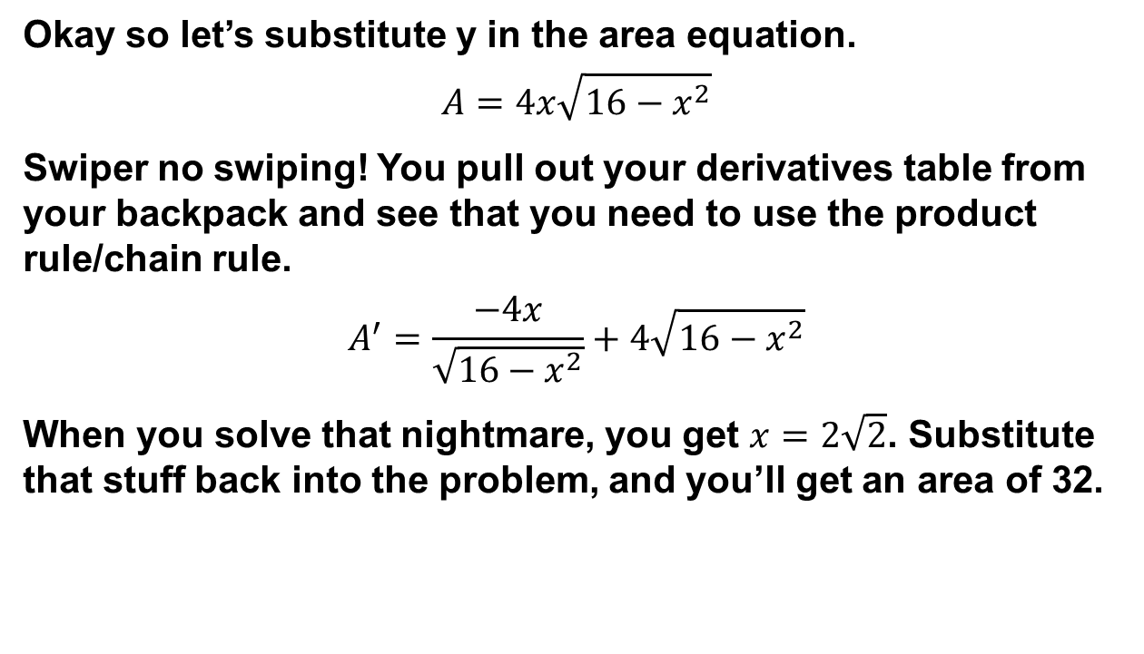
More math yayz
Okay so let’s substitute y in the area equation.
$$A=4x\sqrt{16−x^{2}}$$
Swiper no swiping! You pull out your derivatives table from your backpack and see that you need to use the product rule/chain rule.
$$A^{′}=\frac{−4x}{\sqrt{16−x^{2}}}+4\sqrt{16−x^{2}}$$
When you solve that nightmare, you get $x=2\sqrt{2}$. Substitute that stuff back into the problem, and you’ll get an area of 32.

Slide 14
Related Rates
Related rates are basically implicit differentiation with respect to time. That means you’re going to have to stick a d-something over d-t on both sides of whatever equation you need to do.
Here’s the process:
Identify your knowns, and what you want to know.
Find an equation for a rate that you do know.
Implicitly differentiate and substitute what you know. You should have only one variable left so it should be solvable.

Slide 15
Examples and stuff I guess I don’t know sure
Example: Air is being pumped into a spherical balloon at a rate of 5 cm³/min. Determine the rate at which the radius of the balloon is increasing when the diameter of the balloon is 20 cm.

Slide 16

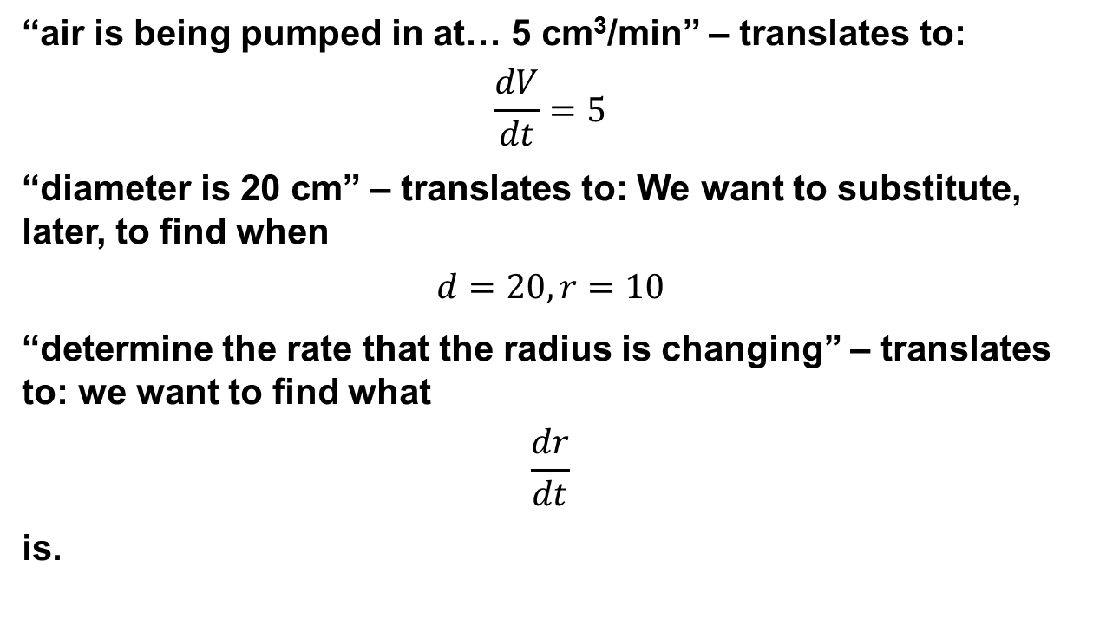
Knowns/UFOS
“air is being pumped in at… 5 cm³/min” – translates to:
$$\frac{dV}{dt}=5$$
“diameter is 20 cm” – translates to: We want to substitute, later, to find when
$$d=20, r=10$$
“determine the rate that the radius is changing” – translates to: we want to find what
$$\frac{dr}{dt}$$
is.

Slide 17
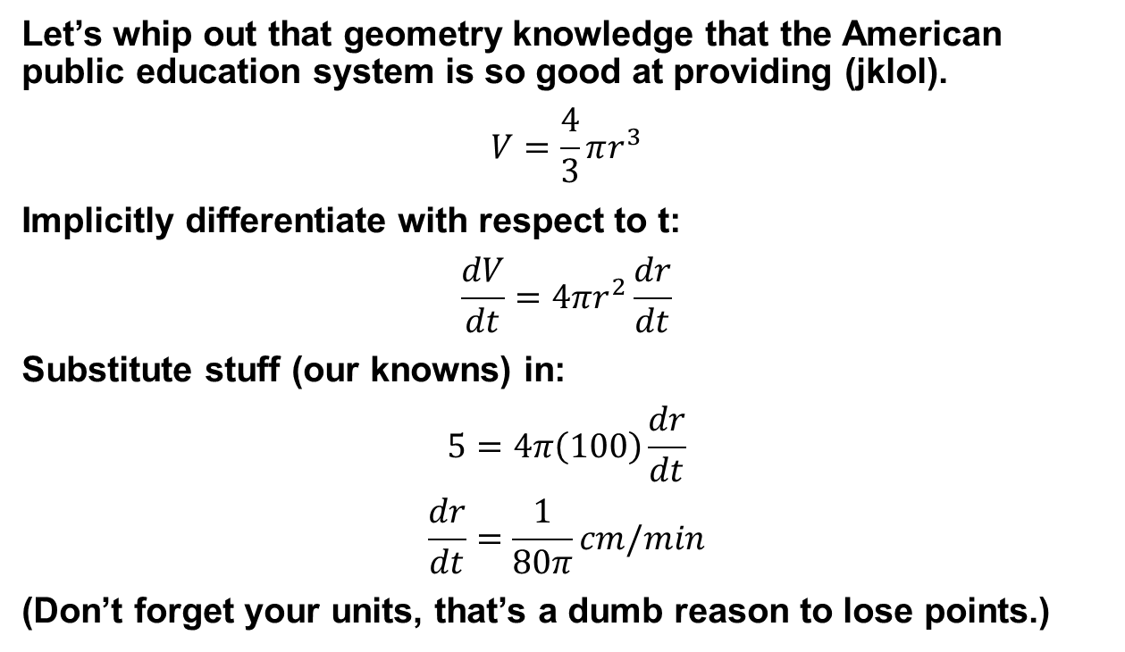
Let’s find an equation yay
Let’s whip out that geometry knowledge that the American public education system is so good at providing (jklol).
$$V=\frac{4}{3}πr^{3}$$
Implicitly differentiate with respect to t:
$$\frac{dV}{dt}=4πr^{2}\frac{dr}{dt}$$
Substitute stuff (our knowns) in:
$$5=4π\left(100\right)\frac{dr}{dt}$$
$$\frac{dr}{dt}=\frac{1}{80π}cm/min$$
(Don’t forget your units, that’s a dumb reason to lose points.)

Slide 18
DG’s Under-the-table, backhand and sneaky tricks
A few tricks with problems in this chapter:
For units, don’t worry about keeping track of your units through the problem. You can just find the answer at the end and then slap the units at the end to make them make sense. Length changes at cm/time, Area changes at cm squared/time and Volume changes at cm cubed/time. Just use the time unit that you’ve been working with.
For any of those sphere (and potentially cylinder problems), the answer of radius changing will have a pi in the denominator.
There’s a great potential that the ladder problems will have a square root in there somewhere from the Pythagoras formula.

Slide 19
Tricks cont.
In general, you can maximize your area by making squares or circles. Although you have to show your proof, just take a second to think about the problem and test the square or circle case to see if that’s a maximize (for example, the second maximization problem ended up being a square).
This is not a trick – just don’t forget your units.

Slide 20
So there you have it
That was chapter 4. Applications of derivatives y’all.
#CalculusTwerkTeam2013

