Slide 1
Boring Generic PowerPoint about Derivatives (Chapter 3)
(Count the number of yoloswags)

Slide 2

Definition of Derivative
What does a derivative even mean?
(Related question: What is love?)
Long story short, a derivative is a slope.
(It doesn’t even need to be of a actual function, in can be of any sort of graph).

Slide 3
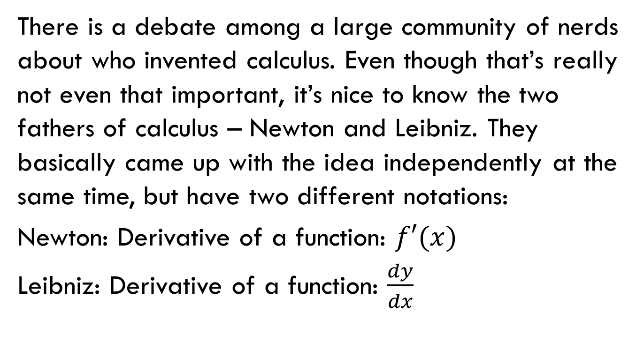
Derivative notations
There is a debate among a large community of nerds about who invented calculus. Even though that’s really not even that important, it’s nice to know the two fathers of calculus – Newton and Leibniz. They basically came up with the idea independently at the same time, but have two different notations:
Newton: Derivative of a function: $f′(x)$
Leibniz: Derivative of a function: $\frac{dy}{dx}$

Slide 4
Why learn both?
Both ways of notating derivatives are important to know. Each has their own times to be convenient.
Here are a bunch of subjective/useless statements:
Newton way: Easier to write, better for derivatives Leibniz way: Makes more sense with integrals

Slide 5
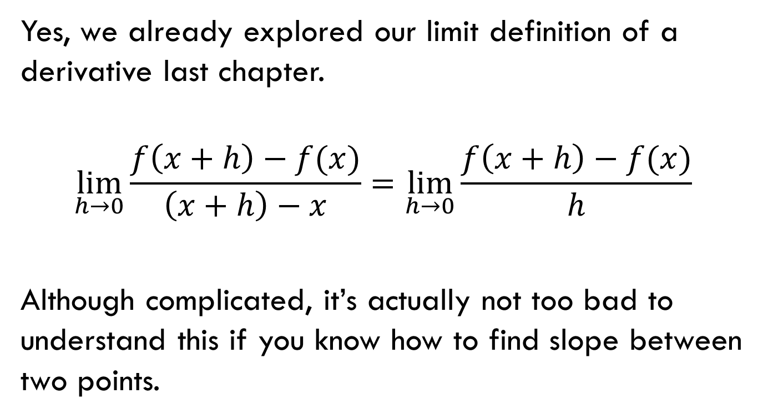
Wait this looks familiar.
yoloswag
Yes, we already explored our limit definition of a derivative last chapter.
$$\lim_{h→0}{\frac{f\left(x+h\right)−f(x)}{\left(x+h\right)−x}=\lim_{h→0}{\frac{f\left(x+h\right)−f(x)}{h}}}$$
Although complicated, it’s actually not too bad to understand this if you know how to find slope between two points.

Slide 6
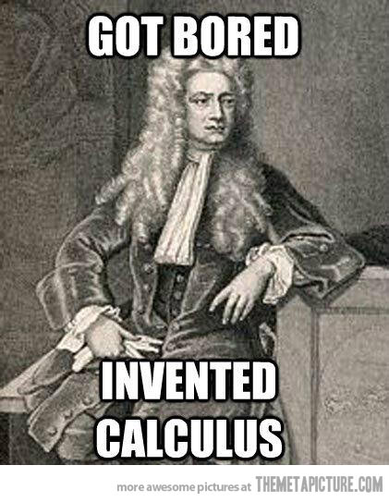
But I’m tired of limit definitioning!
Yes, taking the limit definition can get tiring, time consuming and may cause you to quit calculus.
It’s understandable.
That’s why there a couple of smart
cookies came up with rules for
differentiation.

Slide 7
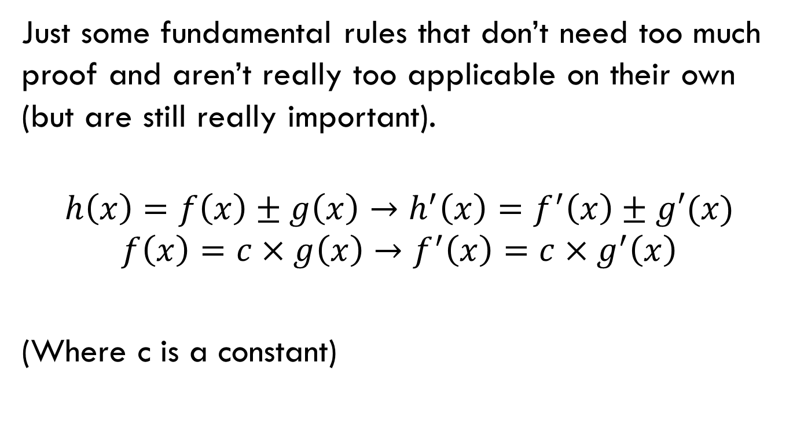
Rule(s) Number Zero: Because I say so.
Just some fundamental rules that don’t need too much proof and aren’t really too applicable on their own (but are still really important).
$$h\left(x\right)=f\left(x\right)±g\left(x\right)→h^{′}\left(x\right)=f^{′}\left(x\right)±g′(x)$$
$$f\left(x\right)=c×g\left(x\right)→f^{′}\left(x\right)=c×g^{′}\left(x\right)$$
(Where c is a constant)

Slide 8
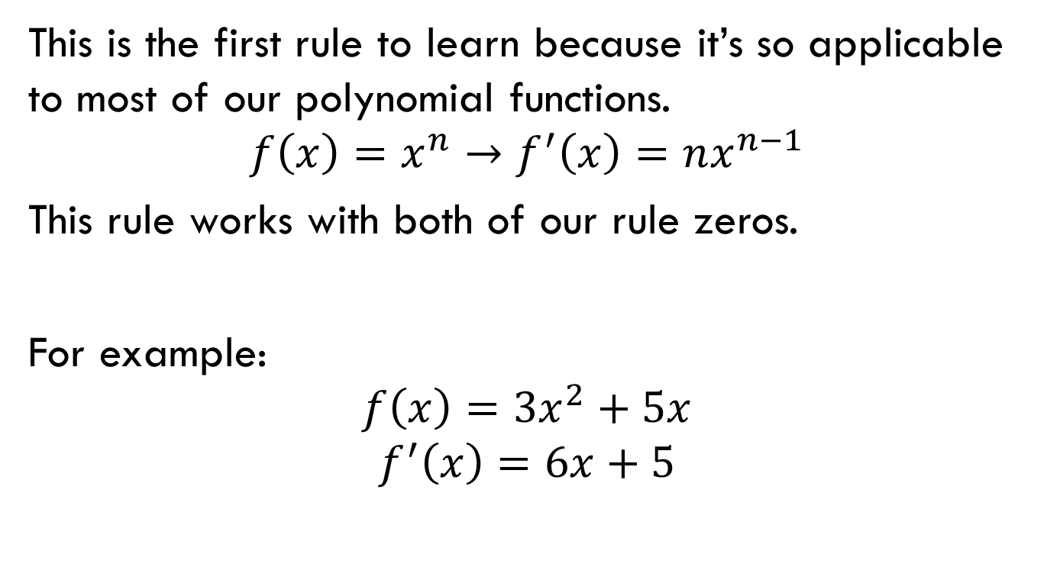
Rule Numero One: Power rule
This is the first rule to learn because it’s so applicable to most of our polynomial functions.
$$f\left(x\right)=x^{n}→f^{′}\left(x\right)=nx^{n−1}$$
This rule works with both of our rule zeros.
For example:
$$f\left(x\right)=3x^{2}+5x$$
$$f^{′}\left(x\right)=6x+5$$

Slide 9

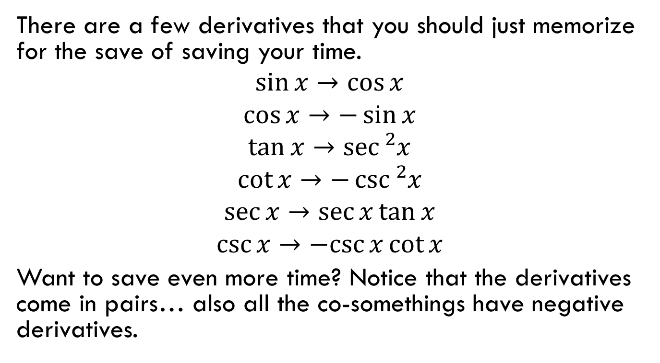
Just some yoloswag to memorize.
There are a few derivatives that you should just memorize for the save of saving your time.
$$\sin{x→\cos{x}}$$
$$\cos{x}→−\sin{x}$$
$$\tan{x}→\sec{{}_{}^{2}x}$$
$$\cot{x}→−\csc{{}_{}^{2}x}$$
$$\sec{x}→\sec{x}\tan{x}$$
$$\csc{x}→−csc{x}\cot{x}$$
Want to save even more time? Notice that the derivatives come in pairs… also all the co-somethings have negative derivatives.

Slide 10
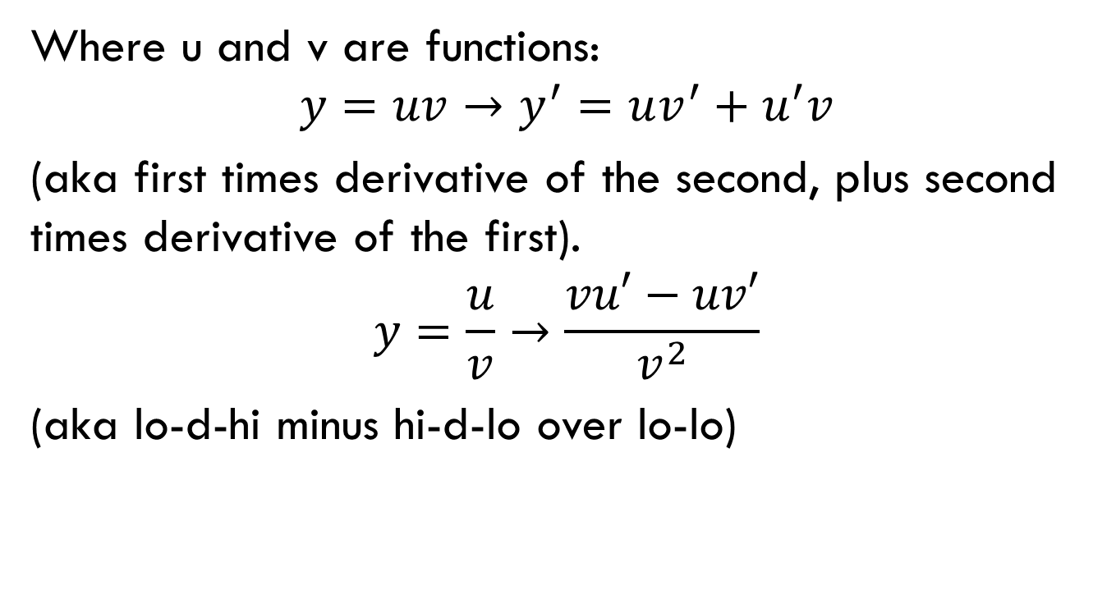
Product/Quotient Rule
Where u and v are functions:
$$y=uv→y^{′}=uv^{′}+u^{′}v$$
(aka first times derivative of the second, plus second times derivative of the first).
$$y=\frac{u}{v}→\frac{vu′−uv′}{v^{2}}$$
(aka lo-d-hi minus hi-d-lo over lo-lo)

Slide 11

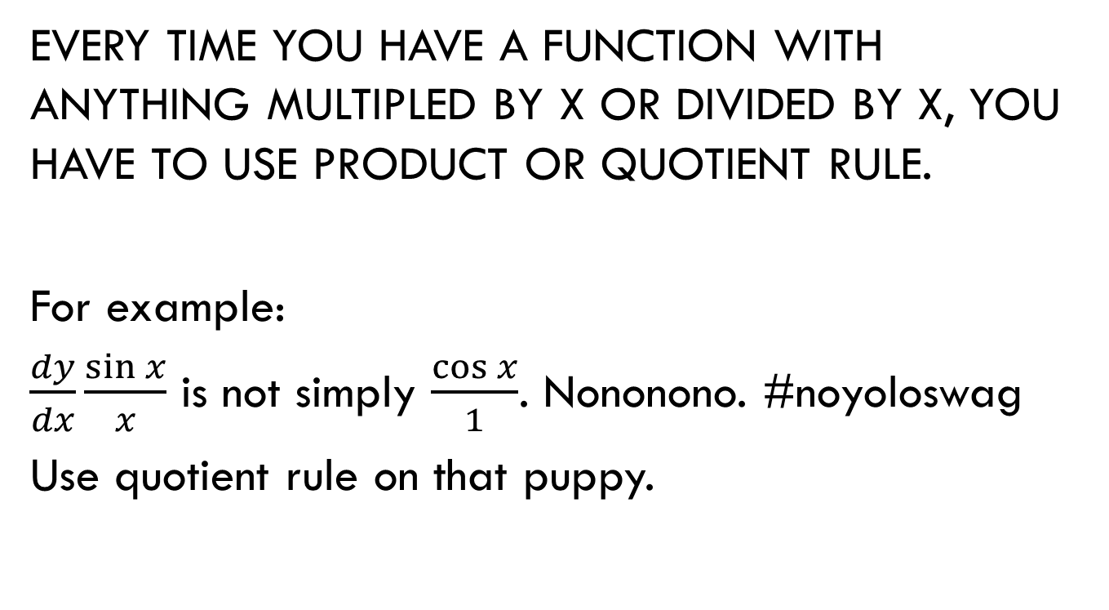
When do I use these?
EVERY TIME YOU HAVE A FUNCTION WITH ANYTHING MULTIPLED BY X OR DIVIDED BY X, YOU HAVE TO USE PRODUCT OR QUOTIENT RULE.
For example:
$\frac{dy}{dx}\frac{\sin{x}}{x}$ is not simply $\frac{\cos{x}}{1}$. Nononono. #noyoloswag
Use quotient rule on that puppy.

Slide 12

Just know this stuff
Position → Velocity → Acceleration
Where an arrow is derivative.
Also, you will likely see the following:
Position → s(t)
Velocity → v(t)
Acceleration → a(t)

Slide 13
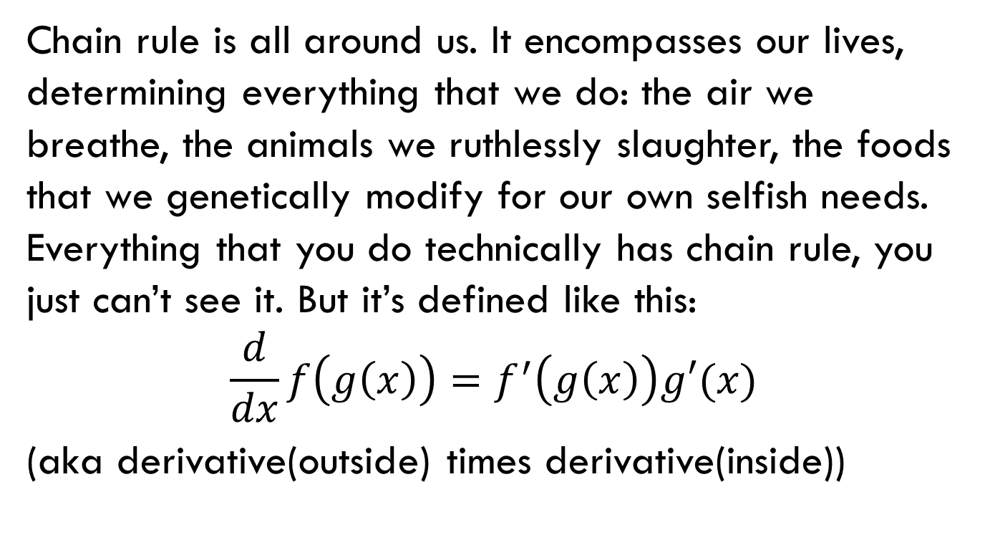
Chain Rule
Chain rule is all around us. It encompasses our lives, determining everything that we do: the air we breathe, the animals we ruthlessly slaughter, the foods that we genetically modify for our own selfish needs. Everything that you do technically has chain rule, you just can’t see it. But it’s defined like this:
$$\frac{d}{dx}f\left(g\left(x\right)\right)=f^{′}\left(g\left(x\right)\right)g′(x)$$
(aka derivative(outside) times derivative(inside))

Slide 14
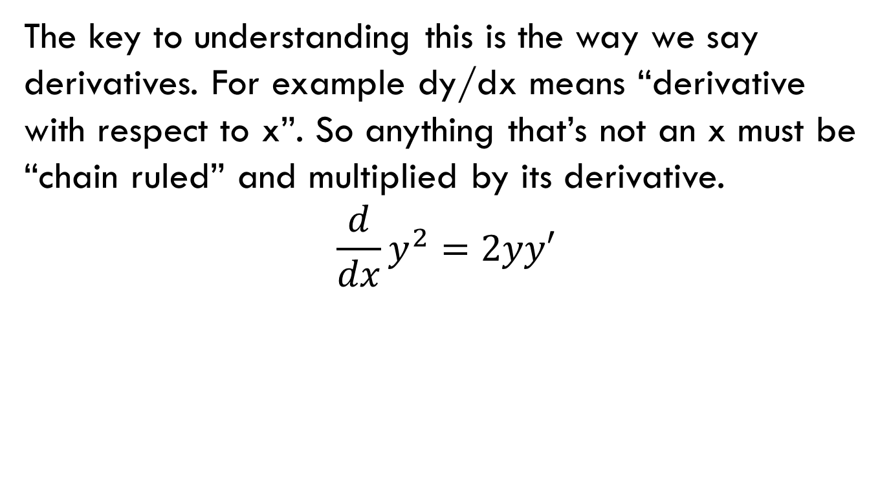
Implicit Differentiation
The key to understanding this is the way we say derivatives. For example dy/dx means “derivative with respect to x”. So anything that’s not an x must be “chain ruled” and multiplied by its derivative.
$$\frac{d}{dx}y^{2}=2yy′$$

Slide 15

Yay lets do it.
One case where you need to know implicit:
$$y=x^{x}$$
Try it! (Hint: take the natural log of both sides, then implicitly differentiate).

Slide 16
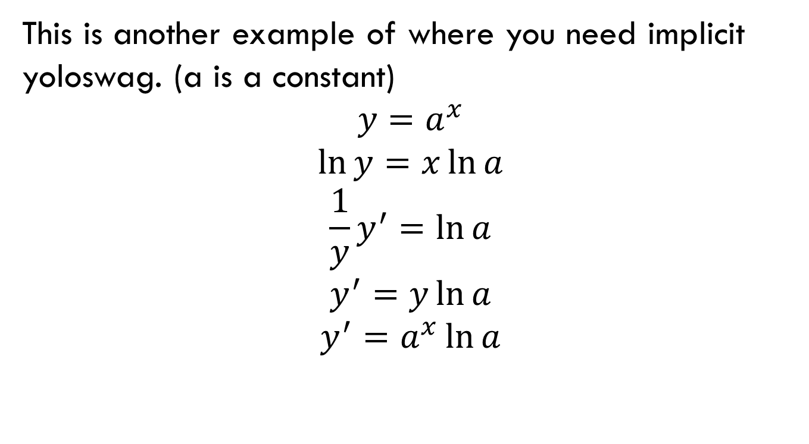
Exponential and Logarithmic Functions
This is another example of where you need implicit yoloswag. (a is a constant)
$$y=a^{x}$$
$$\ln{y}=x\ln{a}$$
$$\frac{1}{y}y^{′}=\ln{a}$$
$$y^{′}=y\ln{a}$$
$$y^{′}=a^{x}\ln{a}$$

Slide 17
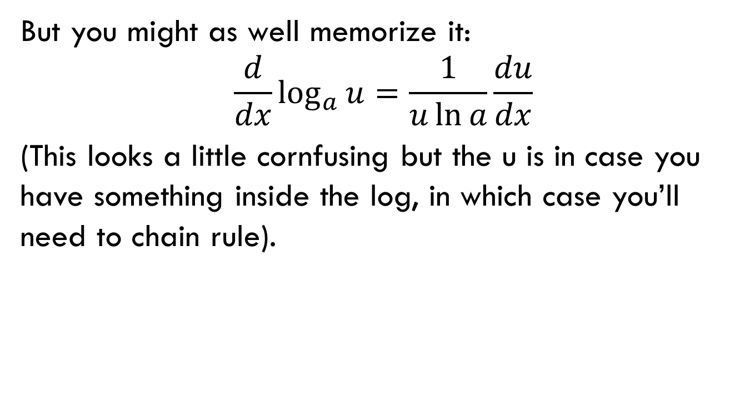
You can prove this too if you want.
But you might as well memorize it:
$$\frac{d}{dx}\log_{a}{u}=\frac{1}{u\ln{a}}\frac{du}{dx}$$
(This looks a little cornfusing but the u is in case you have something inside the log, in which case you’ll need to chain rule).

Slide 18
In summary
Stuff you need to know: (Other than all of it)
Rules:
Power rule
Product/Quotient rule
Chain rule
Other stuff:
Implicitly differentiate
Understand relationships between position, velocity and acceleration.
Stuff to memorize:
Trig derivatives (Remember the co-something thing)
Exponential and log derivatives.

