Slide 1
Limits and Continuity
WOO IT’S PARTY TIME IN THE 509

Slide 2

2.1 rates of Change and Limits
Here’s some stuff you need to know about rates of change and limits...
Average and instantaneous speed
Properties of Limits

Slide 3

Average and instantaneous speed
Average speed is the total distance by time. If the equation for the distance falling of a rock is modeled by the following equation:
$$y=16t^{2}$$
What is the average speed during the first 3 seconds of the fall?

Slide 4
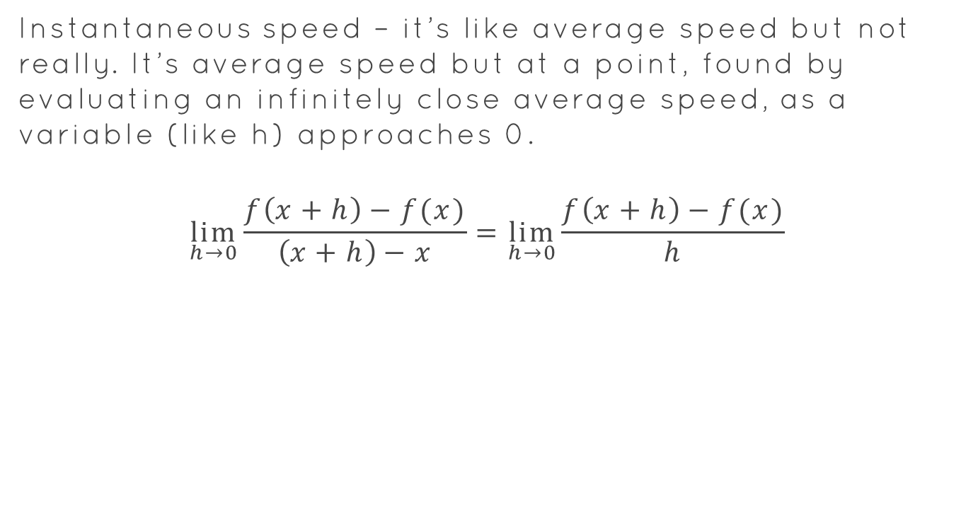
Instantaneous Speed
Instantaneous speed – it’s like average speed but not really. It’s average speed but at a point, found by evaluating an infinitely close average speed, as a variable (like h) approaches 0.
$$\lim_{h→0}{\frac{f\left(x+h\right)−f(x)}{\left(x+h\right)−x}=\lim_{h→0}{\frac{f\left(x+h\right)−f(x)}{h}}}$$

Slide 5
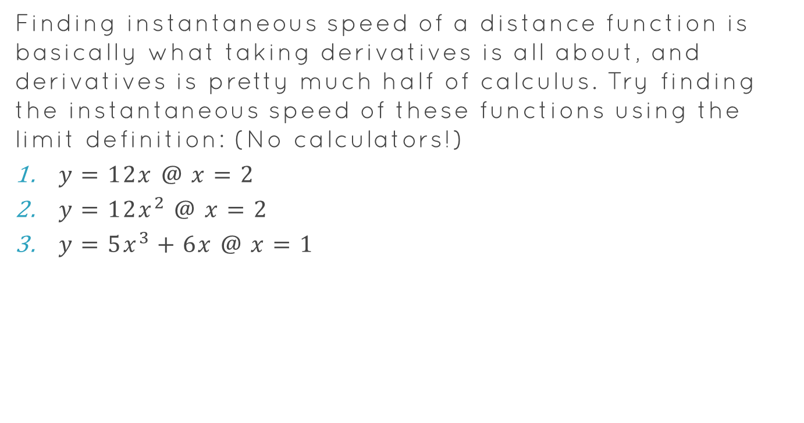
Try it out, Dog
Finding instantaneous speed of a distance function is basically what taking derivatives is all about, and derivatives is pretty much half of calculus. Try finding the instantaneous speed of these functions using the limit definition: (No calculators!)
$y=12x @ x=2$
$y=12x^{2} @ x=2$
$y=5x^{3}+6x @ x=1$

Slide 6
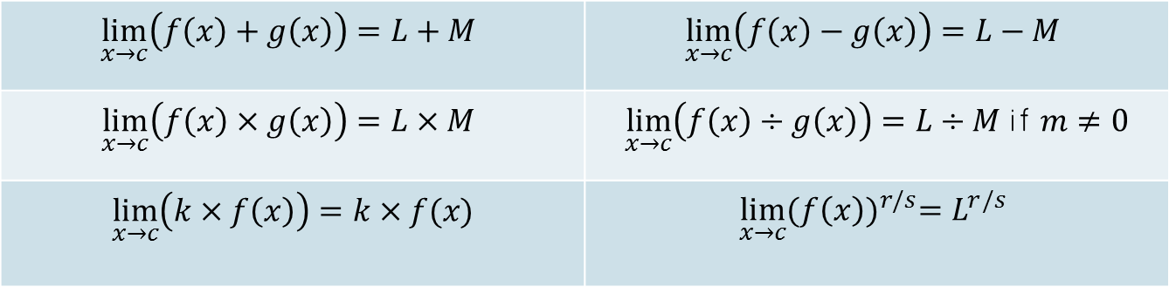

Some properties of limits
Ever had a time in your life where you’re like, “ayo, this limit is way too difficult to find mathematically?”. Well then this section is for you!
Most limit properties are fairly intuitive:
If $\lim_{x→c}{f\left(x\right)=L}$ and $\lim_{x→c}{g\left(x\right)=M}$
$$\lim_{x→c}\left(f\left(x\right)+g\left(x\right)\right)=L+M$$ | $$\lim_{x→c}\left(f\left(x\right)−g\left(x\right)\right)=L−M$$
$$\lim_{x→c}\left(f\left(x\right)×g\left(x\right)\right)=L×M$$ | $\lim_{x→c}\left(f\left(x\right)÷g\left(x\right)\right)=L÷M$ if $m≠0$
$$\lim_{x→c}\left(k×f\left(x\right)\right)=k×f(x)$$ | $$\lim_{x→c}{{(f\left(x\right))}^{r/s}=L^{r/s}}$$

Slide 7


Woo table party time
Try these with your table:
If $\lim_{x→4}{f\left(x\right)=0}$ and $\lim_{x→4}{g\left(x\right)=3}$
$\lim_{x→4}{(g\left(x\right)+3)}$
$\lim_{x→4}{\frac{g(x)}{f\left(x\right)−1}}$
$\lim_{x→4}{xf(x)}$

Slide 8
2.2 Limits involving infinity
Sup dudes this is what we’re reviewing in this section:
Finite limits as x approaches plus/minus infinity

Slide 9
Finite limits to Infinity
One thing to clear up – infinity is not a number. No sir/ma’am, infinity is the concept as a function or axis moves increasingly further right or left. That’s why any limit that evaluates to infinity can be written as undefined.

Slide 10
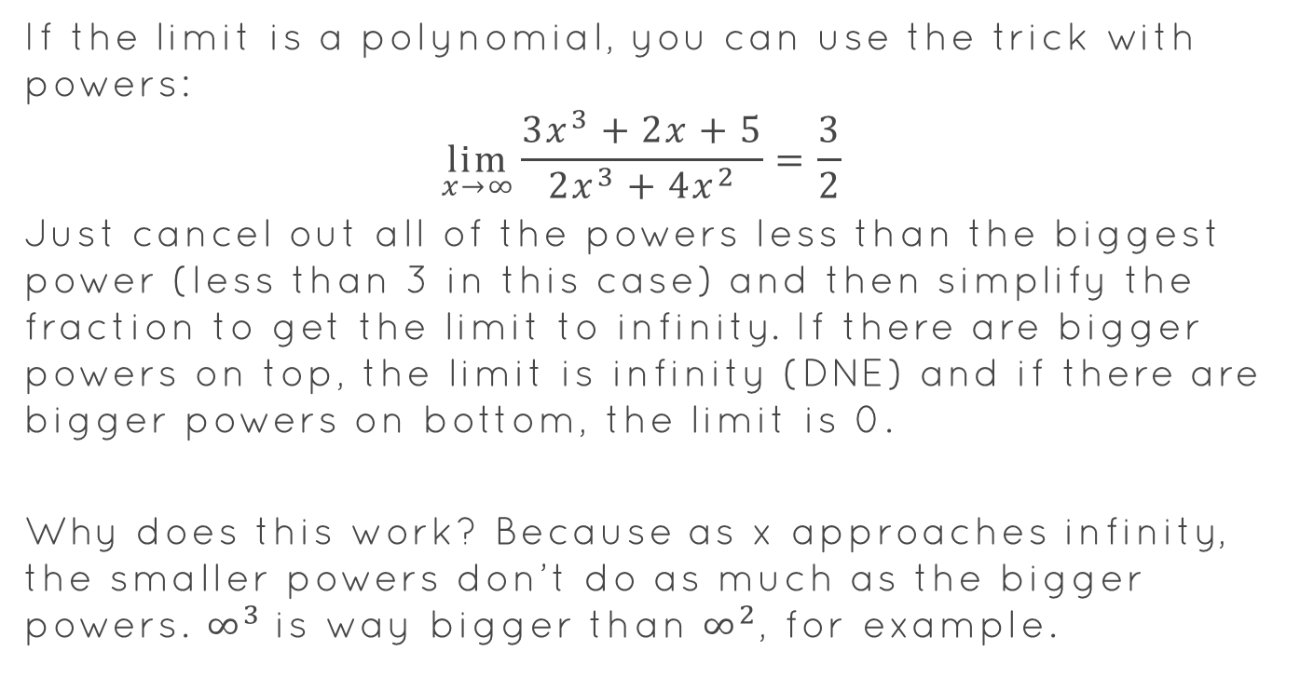
Computing Limits with Infinity
If the limit is a polynomial, you can use the trick with powers:
$$\lim_{x→∞}{\frac{{3x}^{3}+2x+5}{2x^{3}+4x^{2}}}=\frac{3}{2}$$
Just cancel out all of the powers less than the biggest power (less than 3 in this case) and then simplify the fraction to get the limit to infinity. If there are bigger powers on top, the limit is infinity (DNE) and if there are bigger powers on bottom, the limit is 0.
Why does this work? Because as x approaches infinity, the smaller powers don’t do as much as the bigger powers. $∞^{3}$is way bigger than $∞^{2}$, for example.

Slide 11

Table Party Time Part 2
Solve the following limits to infinity:
$\lim_{x→∞}{\frac{{3x}^{4}+{2x}^{3}+{3x}^{2}}{{5x}^{5}+{3x}^{3}+{2x}^{2}}}$
$\lim_{x→∞}{\frac{{2x}^{3}+{100000000000x}^{2}}{{4x}^{3}}}$
$\lim_{x→∞}{\frac{{3x}^{4}+{2x}^{3}+{3x}^{2}}{{5x}^{3}+{3x}^{2}}}$

Slide 12

2.3 Continuity
The mathematical definition of continuity is:
$$\lim_{x→a}{f\left(x\right)=f(a)}$$
Basically, if you draw from the left and from the right, do you need to lift up your pencil to get to point a?

Slide 13
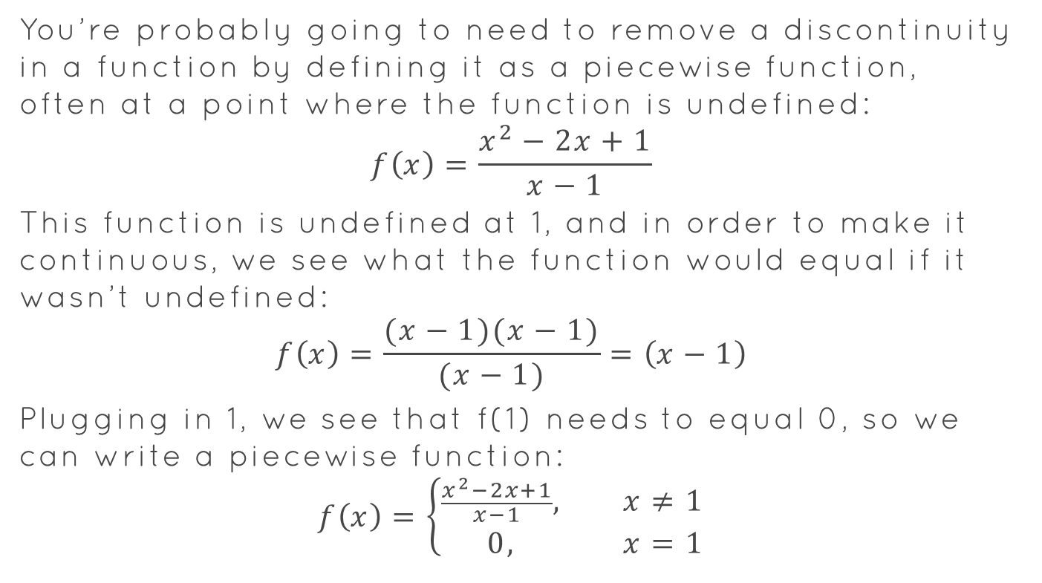
Removing a Discontinuity
You’re probably going to need to remove a discontinuity in a function by defining it as a piecewise function, often at a point where the function is undefined:
$$f\left(x\right)=\frac{x^{2}−2x+1}{x−1}$$
This function is undefined at 1, and in order to make it continuous, we see what the function would equal if it wasn’t undefined:
$$f\left(x\right)=\frac{(x−1)(x−1)}{(x−1)}=\left(x−1\right)$$
Plugging in 1, we see that f(1) needs to equal 0, so we can write a piecewise function:
$$f\left(x\right)=\left\{\begin{aligned}\frac{x^{2}−2x+1}{x−1}, x≠1 \\ 0, x=1\end{aligned}\right.$$

Slide 14
2.4 Rates of Change and Tangent Lines
In this section, you’ll need to know:
Finding tangent lines
Finding normal lines

Slide 15
Finding Tangent Lines
What are the two things that make up a line?
How can we find those parts at a point on a function in order to find the tangent line?

Slide 16
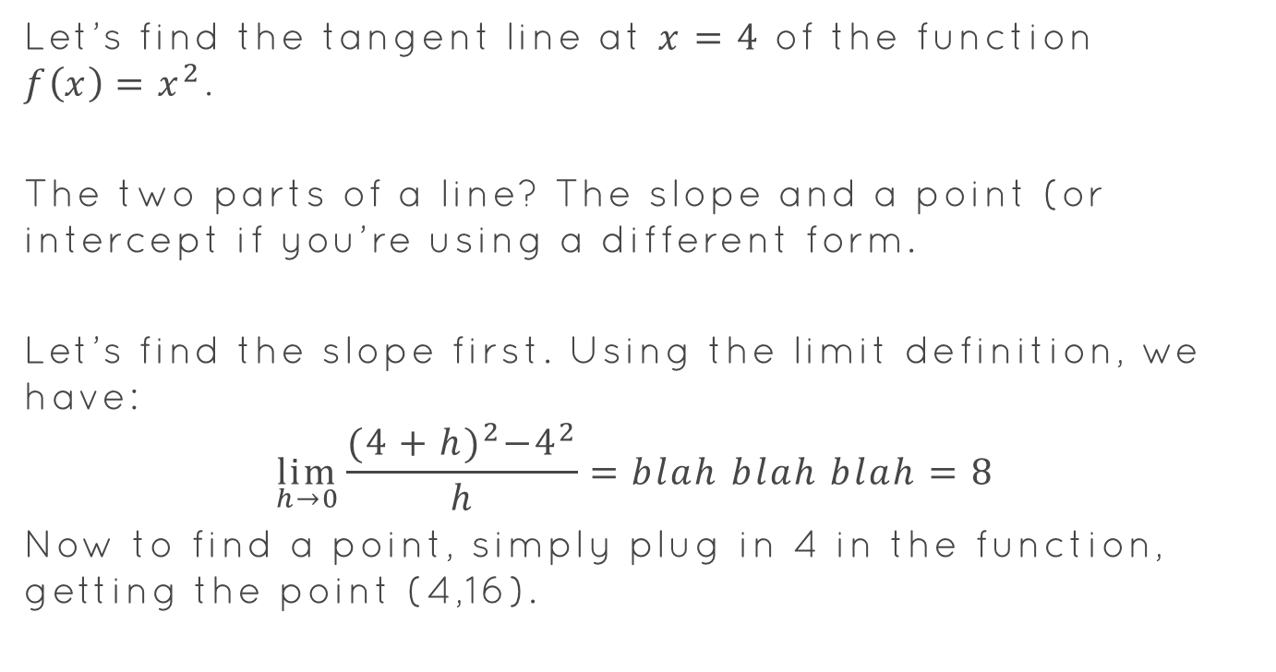
Tangent Lines Part Zwei
Let’s find the tangent line at $x=4$ of the function $f\left(x\right)=x^{2}$.
The two parts of a line? The slope and a point (or intercept if you’re using a different form.
Let’s find the slope first. Using the limit definition, we have:
$$\lim_{h→0}{\frac{{(4+h)}^{2}−4^{2}}{h}}=blah blah blah=8$$
Now to find a point, simply plug in 4 in the function, getting the point (4,16).

Slide 17

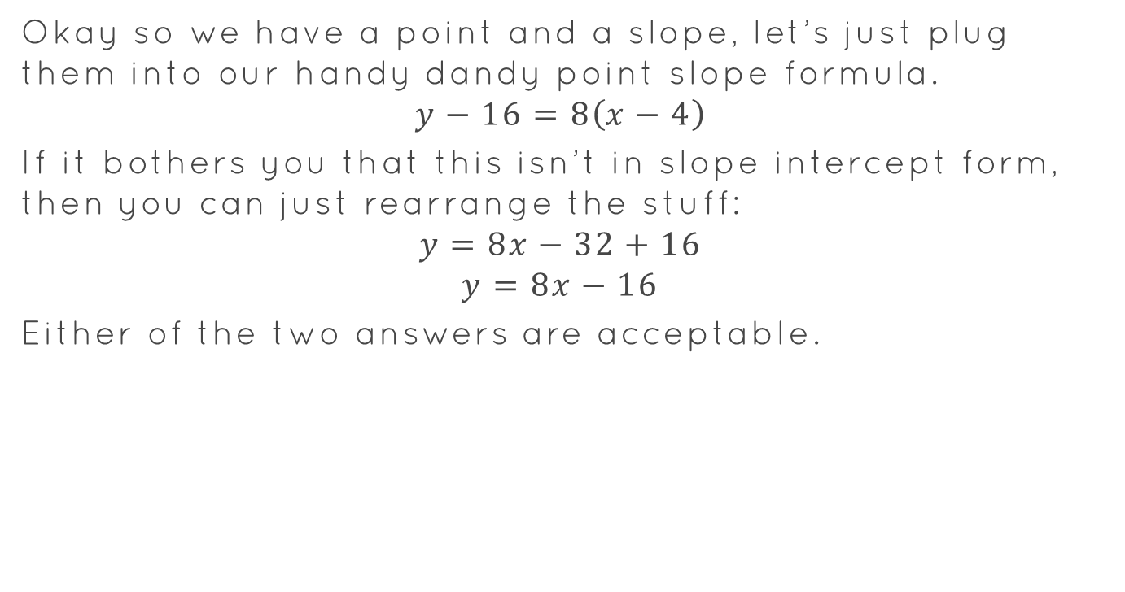
Tangent Lines Part Tres
Okay so we have a point and a slope, let’s just plug them into our handy dandy point slope formula.
$$y−16=8\left(x−4\right)$$
If it bothers you that this isn’t in slope intercept form, then you can just rearrange the stuff:
$$y=8x−32+16$$
$$y=8x−16$$
Either of the two answers are acceptable.

Slide 18

Table Party numéro trois
Find the tangent line to:
$y=9−x^{2}$ at $x=4$
$y=2x−x^{2}$ at $x=3$
$y={3x}^{2}−5x+4$ at $x=$2

